Slide 1
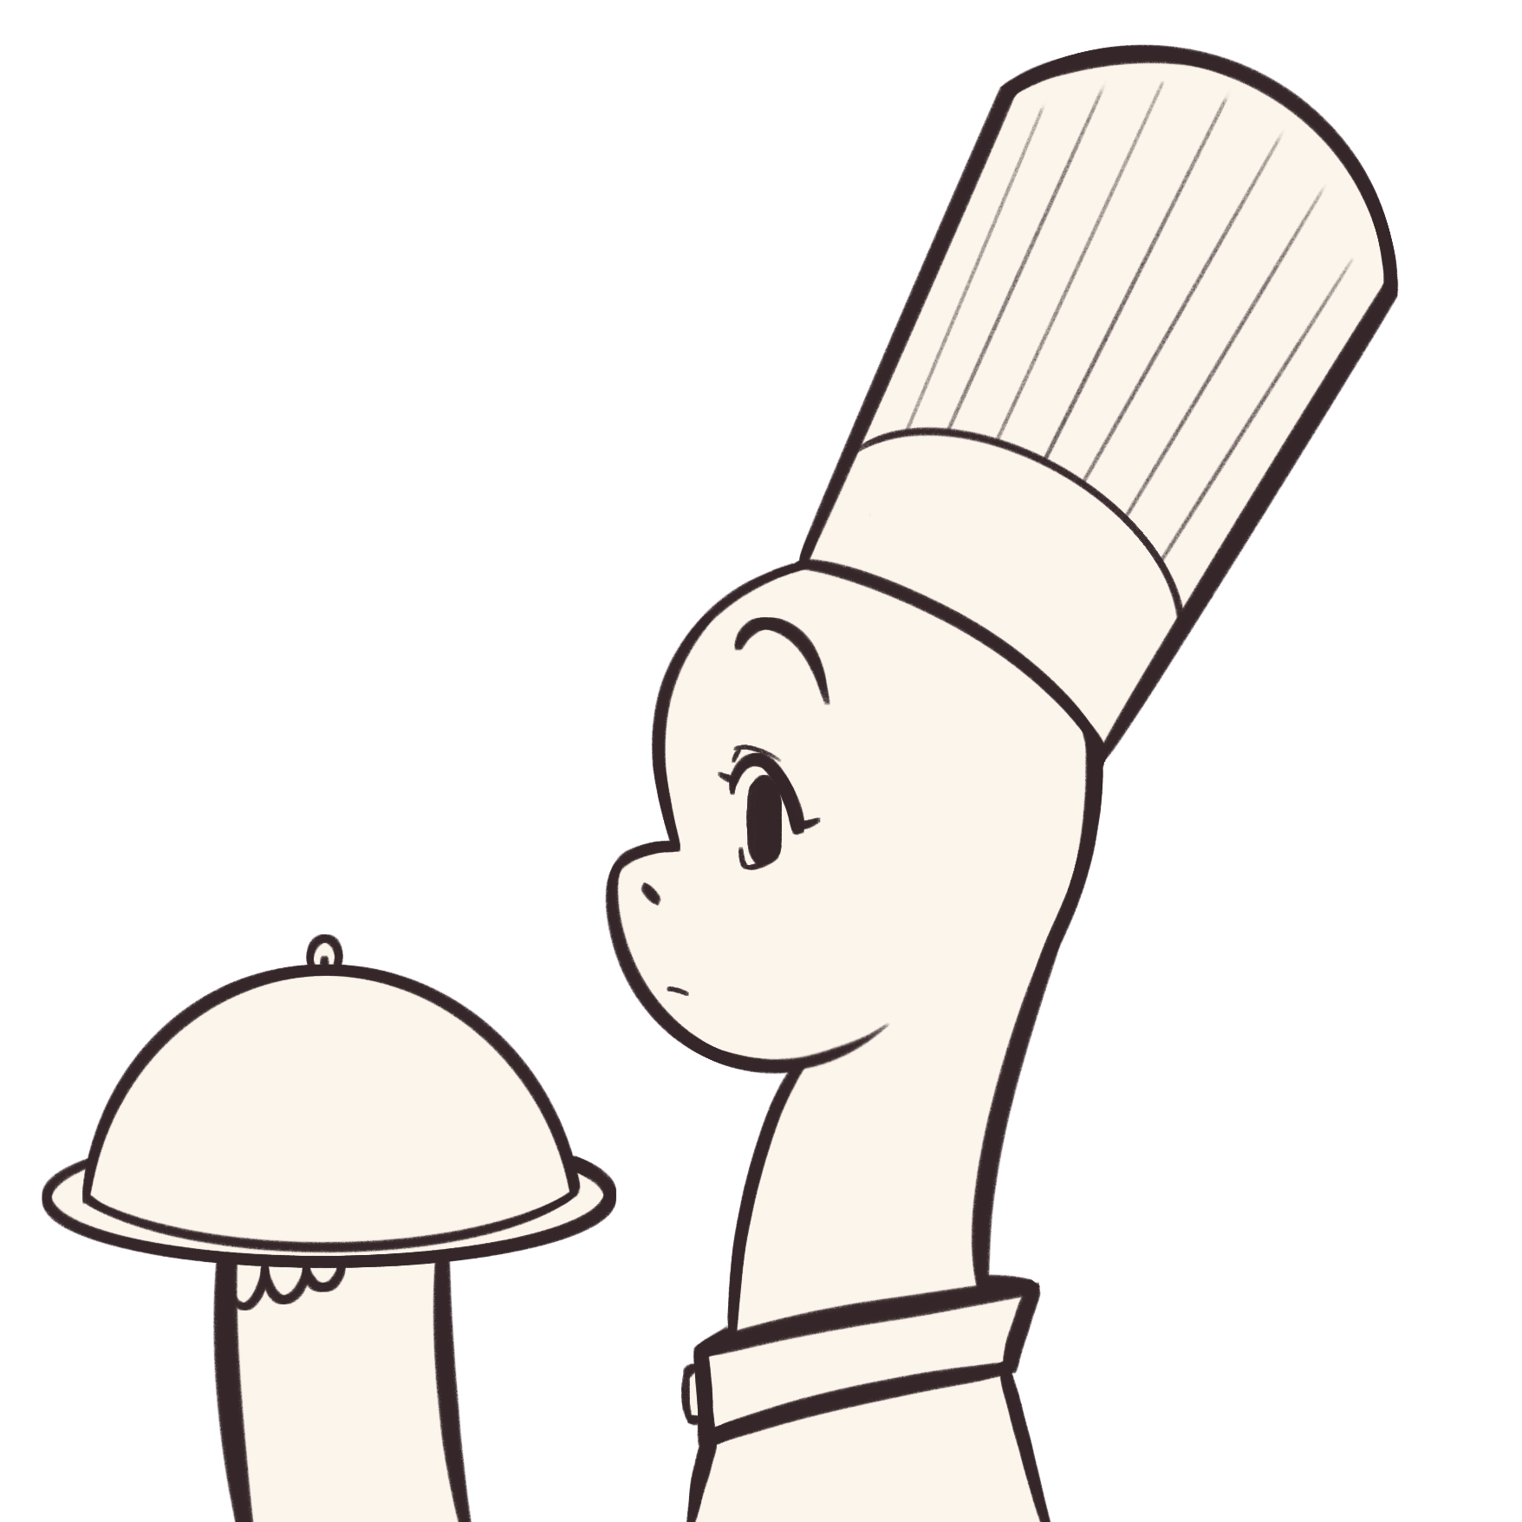
General Instructions
Handwritten Digit Recognition

Slide 2


0.1. Installing Java
You need to have java installed in order to run this.
Not sure if you have java?
Check if you have java installed by running the following command in the terminal: java –help and it should print the java help text if you have installed java.
I have java installed.
I do not have java installed.

Slide 3

0.1. Installing Java
Bruh... You don’t have java? :skull:
Install java from this website. Just get the latest version. While installing, make sure to add it to the PATH in your system!

Slide 4
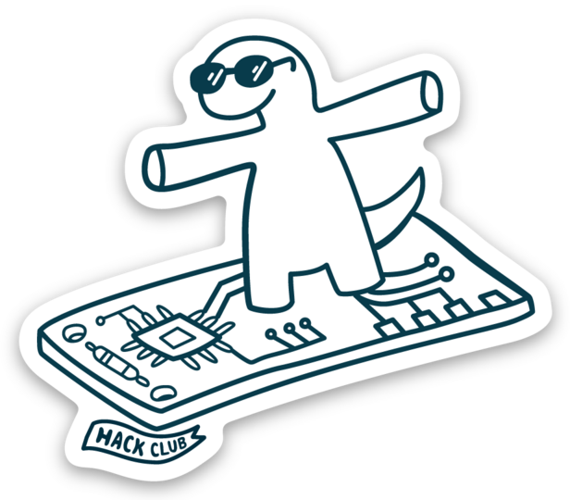
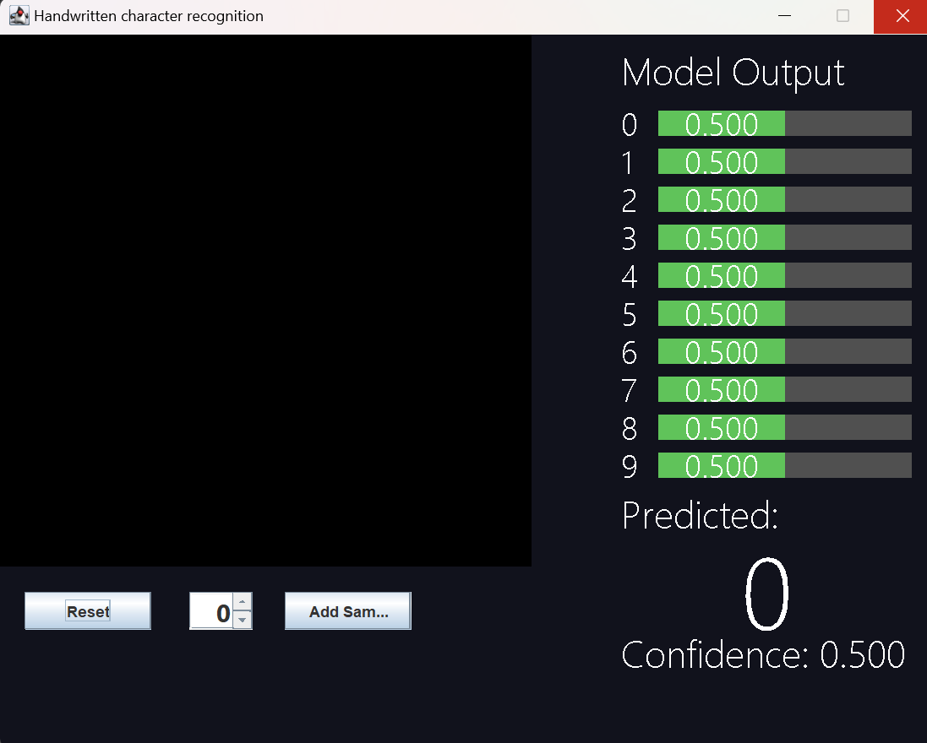
1. Open Main.jar
A .jar file is a compiled java executable.
Open the folder where Main.jar is located. Then right click and select “Open in Terminal”
Run java –jar Main.jar and it should open.
<--Something like this…

Slide 5
2. do stuff!
Draw numbers on the black screen on the left side.
As you draw, the MLP will try to guess which number you’re drawing.
The confidence values of each number is shown as bars on the right side.
Press the Reset button to erase the screen.

